Slide 1

What are we going to see in this session?
What is Templating?
Jinja2 Language
Flow control
Filters

Slide 2
What is Templating
Allows dynamic expressions and access to variables
Can be used in
Tasks
Defaults/Vars
Templates
Templating is done using jinja2 language

Slide 3
Jinja2 Language
Modern and designer friendly templating language for python.
Consists of tags
{% %} – Statement
{{ }} - expression
{# #} - comment
Tags can contain
Flow control
If / else
for
Filters
String ( upper, lower, title, replace, default )
List and set ( min, max, unique, union, intersect, random, join)

Slide 4
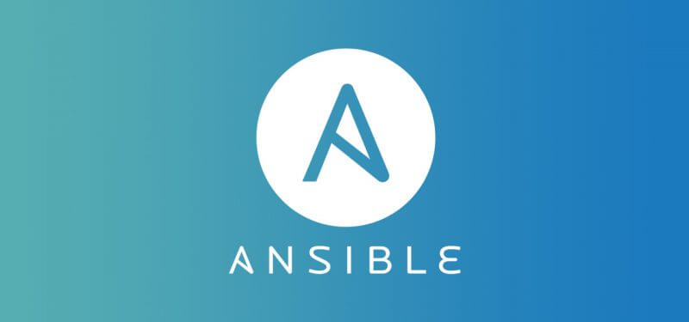
End of this topic !
Any questions?

